Slide 1

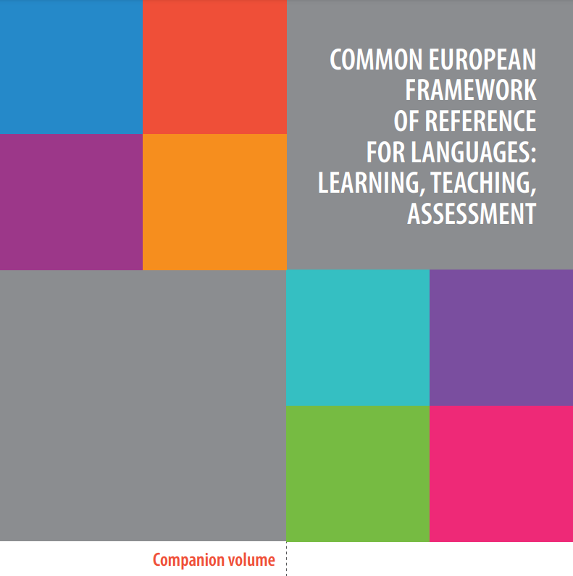
How to use the CEFR Companion Volume
CEFR Companion Volume implementation toolbox
Implémentation du Volume complémentaire du CECR – Boîte d’outils
© 2023. This work is licensed under an Attribution-NonCommercial-ShareAlike International Creative Commons CC-BY-NC-SA 4.0 License. Attribution: Original activity from Fischer Johann (et al.) (2023), CEFR Companion Volume implementation toolbox, Council of Europe (European Centre for Modern Languages), Graz, available at www.ecml.at/companionvolumetoolbox.
Notes:
Slide 1. How to use the CEFR Companion Volume

Slide 2
Introduction
Common European Framework of Reference for Languages: Learning, teaching, assessment (CEFR) – 2001
Language description
use
A1-A2
Goals
quality
comparability
Common reference levels
competences
strategies
B1-B2
C1-C2
plurilingual and pluricultural education

Slide 3
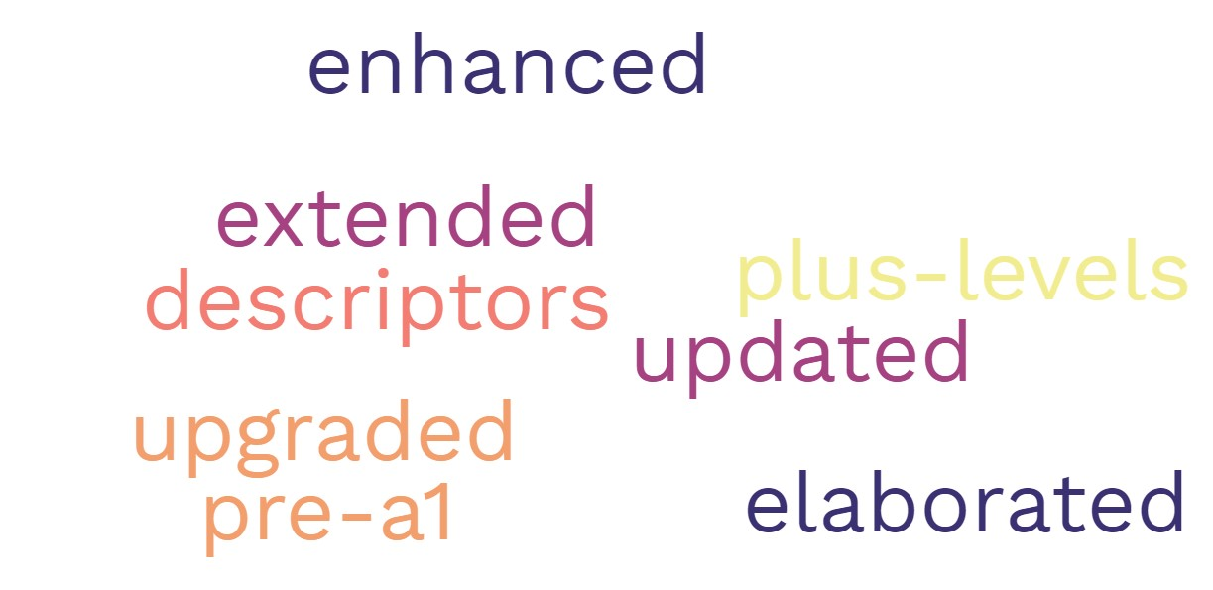
Introduction
Common European Framework of Reference for Languages: Learning, teaching, assessment – Companion Volume (CEFR Companion Volume) – 2020

Slide 4
Introduction
Reception
Action-oriented approach
Production
Learner as a social agent
Interaction
Learner as a communication mediator
Mediation
Language and culture resources
Conceptual framework

Slide 5
Introduction
Rationale, significance and originality
4 new categories of mediation with descriptors: mediating texts, mediating concepts, mediating communication
descriptors of mediation strategies
descriptors of plurilingual and pluricultural competences
descriptors of “plus levels” and a new “Pre-A1” level
more elaborate descriptors of listening, reading, online interaction, using telecommunications, and expressing reactions to creative texts
descriptors of A1, and the C levels, particularly the C2 level
gender-neutral and “modality-inclusive”

Slide 6
CEFR Companion Volume structure
Chapter 1: Introduction
Chapter 2: Key aspects of the CEFR for teaching and learning
Chapter 3: The CEFR illustrative scales: Communicative language activities and strategies
Chapter 4: The CEFR illustrative descriptor scales: Plurilingual and pluricultural competence
Chapter 5: The CEFR illustrative descriptor scales: Communicative language competences
Chapter 6: The CEFR illustrative descriptor scales: Signing competences
https://www.coe.int/en/web/common-european-framework-reference-languages/cefr-descriptors
Appendices

Slide 7
How to use the CEFR Companion Volume
1. Descriptors can provide a detailed, flexible resource for:
‘relating learning aims to real-world language use, thus providing a framework for action-oriented learning’ (CEFR Companion Volume 2020: 42).
Real-life situations
CEFR Companion Volume descriptors
Developing authentic language learning and assessment tasks
Action-oriented approach

Slide 8

How to use the CEFR Companion Volume
2. Descriptors can provide a detailed, flexible resource for:
‘providing transparent “signposting” to learners, parents or sponsors’ (CEFR Companion volume 2020: 42).
  course syllabi
  activity rubrics
  task guidelines
  test specifications
  certification
objectives
achievements

Slide 9
How to use the CEFR Companion Volume
3. Descriptors can provide a detailed, flexible resource for:
developing learner profiles
  facilitating the organisation of the teaching and learning process
  different language ability profiles related to the target language use situations

Slide 10
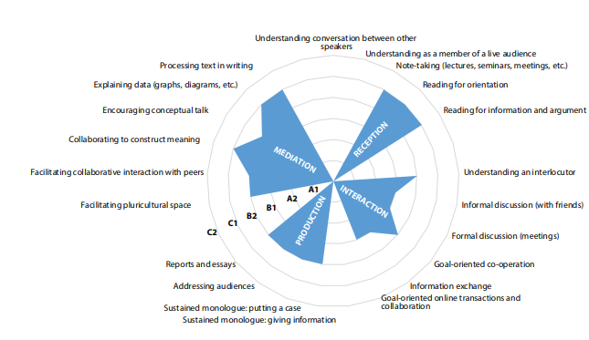
How to use the CEFR Companion Volume
3. Descriptors can provide a detailed, flexible resource for:
developing learner profiles
Fig. 1. Needs in additional language (fictional) – postgraduate natural science (CEFR Companion Volume 2020: 38)

Slide 11
How to use the CEFR Companion Volume
3. Descriptors can provide a detailed, flexible resource for:
developing learner profiles
Fig. 2 . A fictional plurilingual proficiency profile (CEFR Companion Volume 2020: 40)

Slide 12
How to use the CEFR Companion Volume
3. Descriptors can provide a detailed, flexible resource for:
developing learner profiles
Fig. 3. A fictional profile of partial competences in one language (CEFR Companion Volume 2020: 40)

Slide 13
How to use the CEFR Companion Volume
4. Descriptors can provide a detailed, flexible resource for:
‘offering a “menu” to negotiate priorities with adult learners in a process of ongoing needs analysis’ (CEFR Companion Volume 2020: 42);
in teaching, learning and assessing languages for specific purposes (LSP).
Motivation
Learning style
Individual learning needs
Available resources
Learner’s expectations
Time and place
Target language use situation
The learner’s needs according to Hutchinson and Waters (1987:60).

Slide 14

How to use the CEFR Companion Volume
5. Descriptors can provide a detailed, flexible resource for:
‘suggesting classroom tasks to teachers that will involve activities described in several descriptors’ (CEFR Companion Volume 2020: 42).
  Over 1800 illustrative descriptors
  Examples of language activities in personal, public, occupational and educational domains

Slide 15
How to use the CEFR Companion Volume
6. Descriptors can provide a detailed, flexible resource for:
‘introducing criterion-referenced assessment with criteria relating to an external framework (here the CEFR)’ (CEFR Companion Volume 2020: 42).
 | Descriptors of communicative activities (What the learner can do) | Descriptors of aspects of proficiency (How well the learner performs) | Of relevance to
More complex descriptors | Construction of test tasks and rating criteria aligned with curriculum descriptors | Quality-oriented assessment | Insiders: test developers, teachers, examiners,
Simpified descriptors | External user-oriented assessment aims | Self-assessment descriptors and assessment grids for examiners | Outsiders: learners, admission officers, employers, etc. Insiders: examiners
The different purposes of descriptors (adapted from CEFR Companion Volume 2020: 44)

Slide 16

To sum up
Descriptors can serve as an adaptable resource for:
relating learning aims to real-life language use;
providing transparent information about the aims of language learning and assessment to stakeholders;
offering a set of guidelines while conducting needs analysis;
inspiring teachers in the development of classroom tasks;
introducing criterion-referenced assessment with criteria relating to the CEFR framework
aligning language teaching, learning and assessment.

Slide 17
Some useful resources implementing the CEFR framework and illustrative descriptors
1. Web resources
Trim J. (ed.) (2001), “Common European Framework of Reference for Languages: Learning, teaching, assessment – A Guide for Users”, Language Policy Division, Council of Europe, Strasbourg. https://rm.coe.int/1680697848.
Piccardo E. (2014), “From communicative to action-oriented: a research pathway”. https://transformingfsl.ca/wp-content/uploads/ 2015/12/TAGGED DOCUMENT CSC605 ResearchGuide_English_01.pdf
A quality assurance matrix for CEFR use36 (CEFR QualiMatrix). www.ecml.at/CEFRqualitymatrix
CEFTrain (Common European Framework of Reference for Languages in Teacher Training). www.helsinki.fi/project/ceftrain/index.php.35.html
Goullier F. (2007), Council of Europe tools for language teaching – Common European framework and portfolios, Les Editions Didier/Council of Europe, Paris/Strasbourg. https://rm.coe.int/168069ce6e
Equals “Practical resources for language teaching”. www.eaquals.org/our-expertise/cefr/our-work-practical-resources-for-language-teaching/
Beacco J.-C., Byram M., Cavalli M., Coste D., Egli Cuenat M., Goullier F., Panthier J. (2016) Guide for the development and implementation of curricula for plurilingual and intercultural education, Council of Europe Publishing, Strasbourg.
Piccardo E., Berchoud M., Cignatta T., Mentz O., Pamula M. (2011) Pathways through assessing, learning and teaching in the CEFR, Council of Europe Publishing / European Centre for Modern Languages, Strasbourg / Graz.
PRO-Sign: Promoting Excellence in Sign Language Instruction. www.ecml.at/prosign
2. Books
Bourguignon C. (2010), Pour enseigner les langues avec les CERCL – Clés et conseils, Delagrave, Paris.
Lions-Olivieri M-L. and Liria P. (eds) (2009), L’approche actionnelle dans l’enseignement des langues. Douze articles pour mieux comprendre et faire le point, Difusion – Maison des Langues, Paris.
North B. (2014), The CEFR in practice, Cambridge University Press, Cambridge.
North B., Angelova M. and Rossner R. (2018), Language course planning, Oxford University Press, Oxford.
Piccardo E. and North B. (2019), The action-oriented approach: a dynamic vision of language education, Multilingual Matters, Bristol.
Rosen E. and Reinhardt C. (eds) (2010), Le point sur le Cadre européen commun de référence pour les langues, CLE international, Paris.

Slide 18
Bibliography:
Council of Europe (2001) Common European Framework of Reference for Languages: Learning, Teaching, Assessment. Cambridge: Cambridge University Press. https://rm.coe.int/1680459f97
Council of Europe (2020) Common European Framework of Reference for Languages: Learning, teaching, assessment. Companion volume. Strasbourg: Council of Europe Publishing.
https://rm.coe.int/common-european-framework-of-reference-for-languages-learning-teaching/16809ea0d4
Hutchinson, Tom and Alan Waters (1987) English for Specific Purposes. Cambridge: Cambridge University Press.

